Slide 1
Mini -Project

Slide 2
Problem Statement
Our goal is to predict whether a meme is hateful or non-hateful. This is a binary classification problem with multimodal input data consisting of the meme image itself (the image mode) and a string representing the text in the meme image (the text mode).

Slide 3
Sub-Tasks :
Task 1 : Categorization of Memes :
Task 2 : Reasoning Of Memes :

Slide 4
Related Works

Slide 6
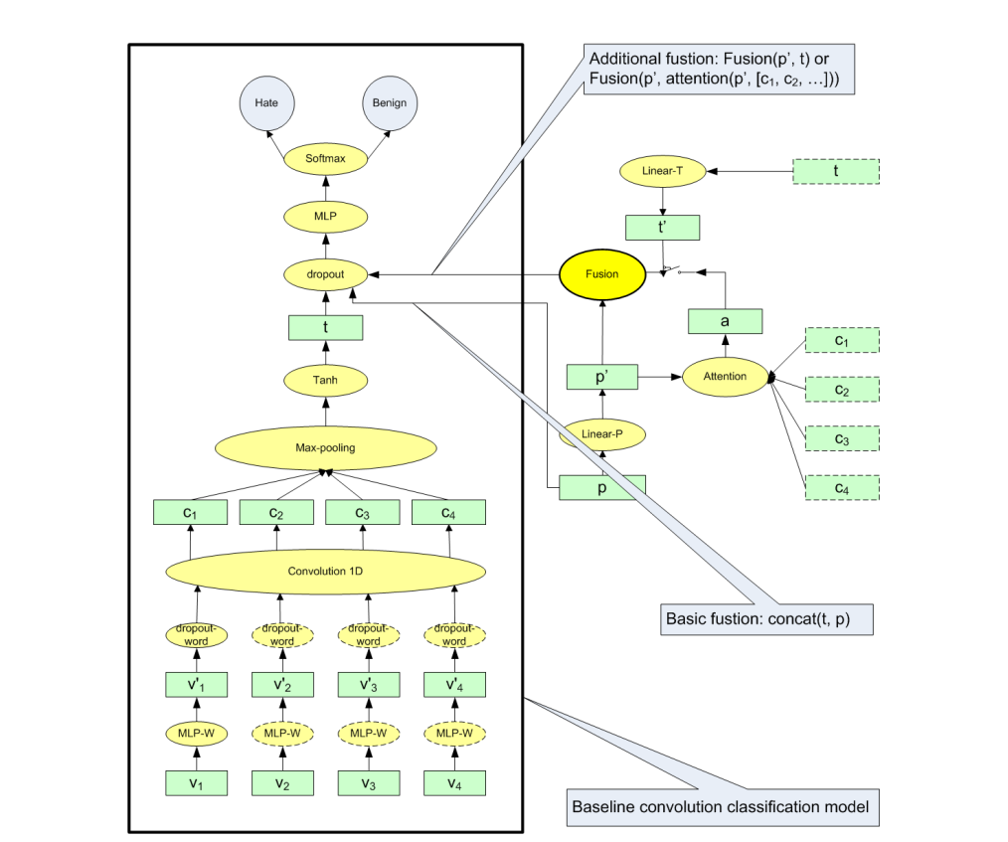
Exploring Deep Multimodal Fusion of Text and Photo for Hate Speech Classification
Proceedings of the Third Workshop on Abusive Language Online , 2019
MLP-W : Serves as solution for fine-tuning word embeddings to hate speech domain.
Gated Summation

Slide 7
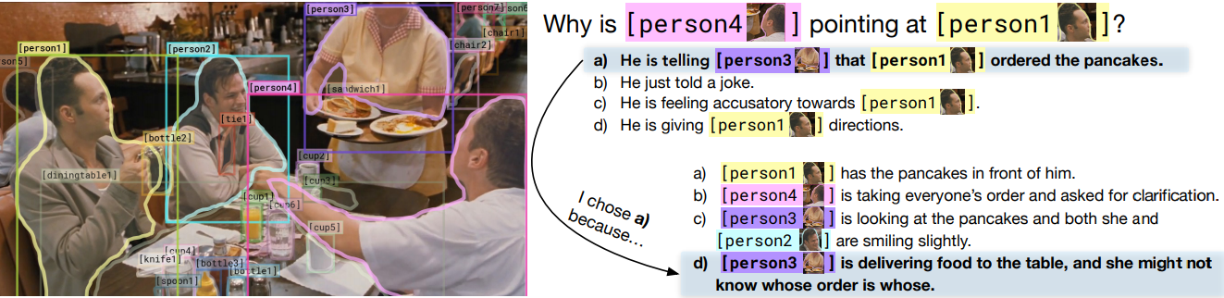
From Recognition to Cognition: Visual Commonsense Reasoning
https://arxiv.org/pdf/1811.10830.pdf
Dataset : Visual Commonsense Reasoning
Collected from Large Scale Movie Description Challenge and YouTube movie clips
List of objects
A query
A set of N responses

Slide 8
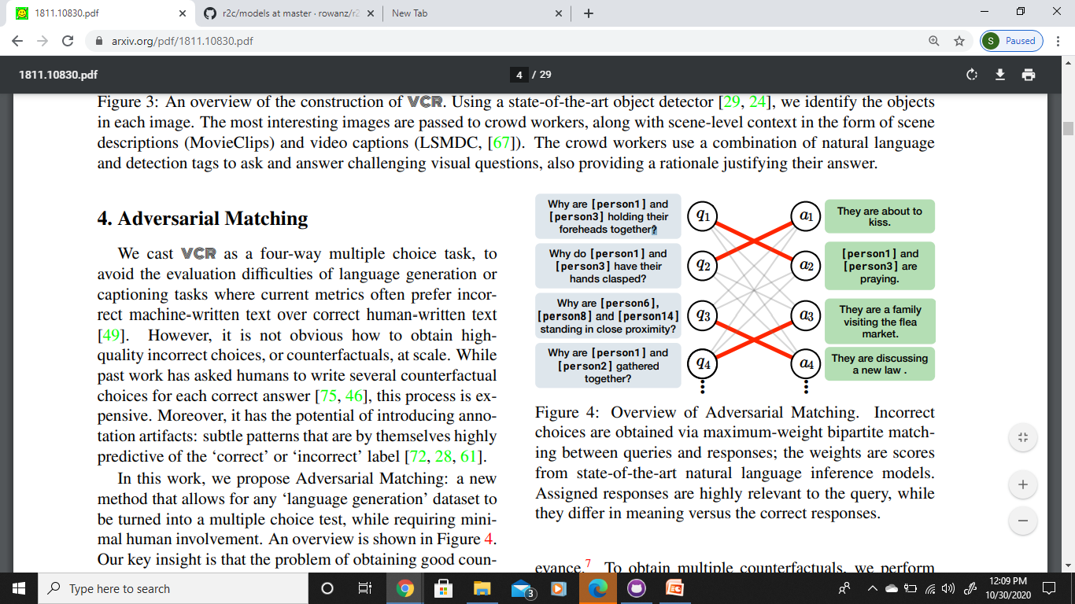
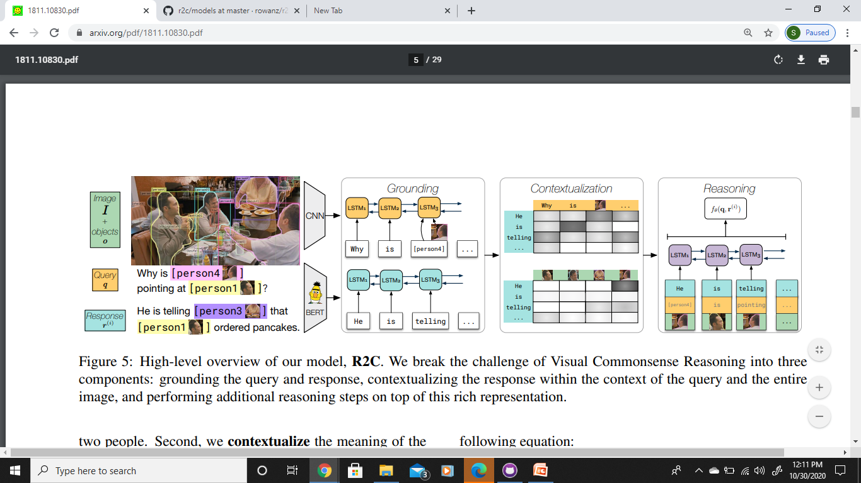
Adversarial Matching
For Question Answering Q -> A
Language generation dataset to Multiple Choice Test
Two subtasks:
- Answer is as relevant as possible
- Dissimilarity between other answers are from the correct answer
Maximum weight bipartite matching
Recognition to Cognition Model
QA -> R
Grounding
Contextualization
Reasoning

